Slide 1
Metis
INTRO TO DATA SCIENCE
LECTURE 14: RECOMMENDER SYSTEMS
Paul Burkard 12/14/2015

Slide 2
Recommenders

Slide 3
Agenda
RECOMMENDER SYSTEMS
CONTENT-BASED RECOMMENDATION
COLLABORATIVE FILTERING
HANDS-ON: RECOMMENDER SYSTEMS

Slide 4
Learning Goals
What are Recommender Systems?
Why do we need them?
What are some common use cases?
What are the 2 main types of Recommender Systems?
How do they diﬀer?
What are their respective strengths/weaknesses?

Slide 5
Recommender Systems

Slide 6
Recommenders
Q: What are Recommender Systems?
A: Automated systems that seek to suggest whether a given item (product, event, movie, song, etc) will be desirable to a user.
They often build on the back of machine learning concepts we’ve seen previously. They’ve become ubiquitous in today’s web-based world, so there are many diﬀerent applications…

Slide 7
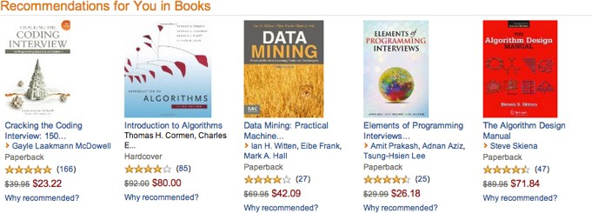
Examples - Amazon

Slide 8
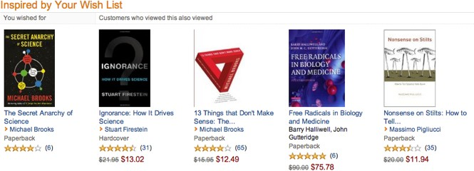
Examples – Amazon

Slide 9
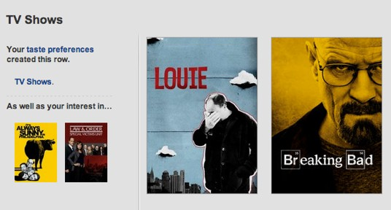
Examples – Netflix

Slide 10
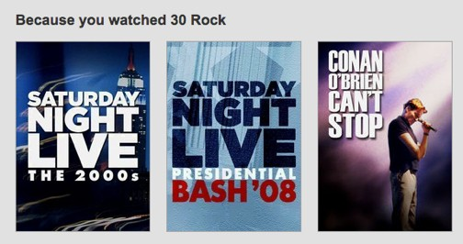
Examples – Netflix

Slide 11
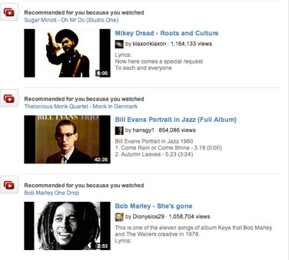
Examples – Youtube

Slide 12
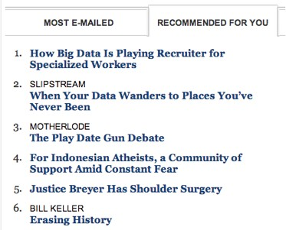
Examples – NYTimes

Slide 13
Examples – NYTimes

Slide 14
Recommender Systems
There are two general approaches to their design:
In content-based filtering, items are mapped into a feature space, and recommendations depend on specified characteristics.
In contrast, the only data under consideration in collaborative filtering are user-item ratings, and recommendations depend on user preferences.

Slide 15
Content Based Recommenders

Slide 16
CONTENT-BASED RECOMMENDERS
Content-based recommendation begins by mapping each item into a feature space. Both users and items are represented by vectors in this space.
Two approaches:
Map users and items to same feature space, compute distance between a user and item
Create features from user+item pairs and use ML algorithm to predict like/ dislike

Slide 17
CONTENT-BASED RECOMMENDATION
1) Map users and items to same feature space, compute distance between a user and item
Item vectors measure the degree to which the item is described by each feature, and user vectors measure a user’s preferences for each feature.
1) Toy Story -> (Comedy: 1, Animated: 1, Mafia: 0) Godfather -> (Comedy: 0, Animated, Mafia: 1)
User 1 -> (Comedy 1, Animated: 0, Mafia: 0)

Slide 18
EXAMPLE – CONTENT-BASED RECOMMENDATION
features = (big box oﬃce, aimed at kids, famous actors)
items (movies):
Finding Nemo = (5, 5, 2)
Mission Impossible = (3, -5, 5)
Jiro Dreams of Sushi = (-4, -5, -5)
predicted ratings*:
(-3*5 + 2*5 -2*2) = -9
(-3*3 - 2*5 -2*5) = -29
(3*4 - 2*5 + 2*5) = +12
users:
Jason = (-3, 2, -2)

Slide 19
CONTENT-BASED RECOMMENDATION
2) Create features from user+item pairs and use ML algorithm (classifier for instance) to predict like/dislike
Each sample/row is a user/item pair with some outcome: Outcome = Bought
User features - (purchase power, demographics) Item features - category, metadata
User/Item features - user/item category overlap

Slide 20
CONTENT-BASED RECOMMENDATION
One notable example of content-based filtering is Pandora, which maps songs into a feature space using features (or “genes”) designed by the Music Genome Project.
Using song vectors that depend on these features, Pandora can create a station with music having similar properties to a song, genre, artist etc. the user selects.

Slide 21
CONTENT-BASED RECOMMENDATION
Content-based recommendation has some diﬃculties:
need to map each item into a feature space (usually by hand!)
recommendations are limited in scope (items must be similar to each other)
hard to create cross-content recommendations (eg books/music films…this would require comparing elements from diﬀerent feature spaces!)

Slide 22
Collaborative Filtering

Slide 23
RECOMMENDATION SYSTEMS
The purpose of a recommendation system is to decide whether an item (product, event, movie, song) is something a user is highly likely to be interested in
REFRAMED AS:
The purpose of a recommendation system is to predict a rating that a user will give an item that they have not yet rated.

Slide 24
COLLABORATIVE FILTERING
Collaborative filtering refers to a family of methods for predicting ratings where instead of thinking about users and items in terms of a feature space, we are only interested in the existing user-item ratings themselves.
In this case, our dataset is a ratings matrix whose columns correspond to items, and whose rows correspond to users.

Slide 25
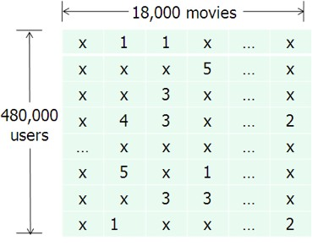

RATINGS MATRIX
NOTE
This matrix will always be sparse!
source: http://www.eecs.berkeley.edu/~zhanghao/main/publications/subfolder/netflix.png

Slide 26
COLLABORATIVE FILTERING
Collaborative filtering can be done in two diﬀerent ways.
Item-based CF uses ratings data to create an item-item similarity matrix.
Recommendations are then made to a user for items most similar to those that the user has already rated highly.
This is also called memory-based CF or neighborhood methods

Slide 27
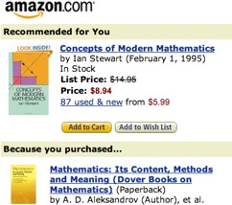

COLLABORATIVE FILTERING
Neighborhood methods such as item-based CF are popular and easy to understand, but they don’t scale well.
NOTE
Item-based CF is different than content- based filtering!
Though we’re making recommendations based on items, we are not embedding the items in a feature space.

Slide 28
COLLABORATIVE FILTERING
Model-based collaborative filtering abandons the neighborhood approach and applies other techniques to the ratings matrix.
The most popular model-based CF techniques use matrix decomposition techniques to find deeper structure in the ratings data.
For example, we could decompose the ratings matrix via SVD to reduce the dimensionality and extract latent variables.

Slide 29
COLLABORATIVE FILTERING
Once we identify the latent variables in the ratings matrix, we can express both users and items in terms of these latent variables.
As before, values in the item vectors represent the degree to which an item exhibits a given feature, and values in the user vectors represent user preferences for a given feature.
Ratings are constructed by taking dot products of user & item vectors in the latent feature space.

Slide 30
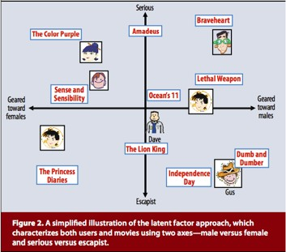
COLLABORATIVE FILTERING
source: http://www2.research.att.com/~volinsky/papers/ieeecomputer.pdf

Slide 31
COLLABORATIVE FILTERING
This approach is domain independent, and requires no explicit user or item profiles to be created.
It combines predictive accuracy, scalability, and enough flexibility for practical modeling (we’ll see what this means in a moment).
Since the conclusion of the Netflix prize, these latent factor methods for collaborative filtering have been regarded as the state-of-the-art in recsys technology.

Slide 32
COLLABORATIVE FILTERING
But they do have some drawbacks:
lots of (high-dimensional) ratings data needed
data is typically very sparse (in the Netflix prize dataset, ~99% of possible ratings were missing)
cold start problem: need lots of data on new user or item before recommendations can be made

Slide 33
COLD START PROBLEM
The cold start problem arises because we’ve been relying only on ratings data, or on explicit feedback from users.
Until a user rates several items, we don’t know anything about her preferences!
We can get around this by enhancing our recommendations using implicit feedback, which may include things like item browsing behavior, search patterns, purchase history, etc.

Slide 34
COLD START PROBLEM
While explicit feedback (ratings, likes, purchases) leads to high quality ratings, the data is sparse and cold starts are problematic.
Meanwhile implicit feedback (browsing behavior, etc) leads to less accurate ratings, but the data is much more dense (and less invasive to collect).
Implicit feedback can help to infer user preferences when explicit feedback is not available, therefore easing the cold start problem.

Slide 35
HYBRID METHODS
Hybrid filtering methods provide another way to get around the cold start problem by combining filtering methods (eg, by using content- based info to “boost” a collaborative model).
This content-based info can be item-based as above, or even user- based (eg, demographic info).
Hybrid methods can also make the data sparsity issue easier to deal with, by broadening the set of features under consideration.

